Slide 1
Automotive Embedded System

Slide 2
Embedded systems
An embedded system is a system that has embedded software and hardware, which makes it a system dedicated for an application(s), or a part of larger systems.
Example : Bluetooth control home appliances.

Slide 3
Real time examples
Consumer electronics
Banking sector
Medical
Industrials
Transportations,(AES) etc..,

Slide 4
Embedded System in Automobile
Embedded system are extensively used in Automobile Industry. Embedded system have taken control on automobiles
Airbags
Anti-lock breaking system
Automatic parking
Satellite Radio
Tyre Pressure Monitor (TPM)
In-vehicle entertainment system
Navigation systems
Night vision
Heads up display

Slide 5
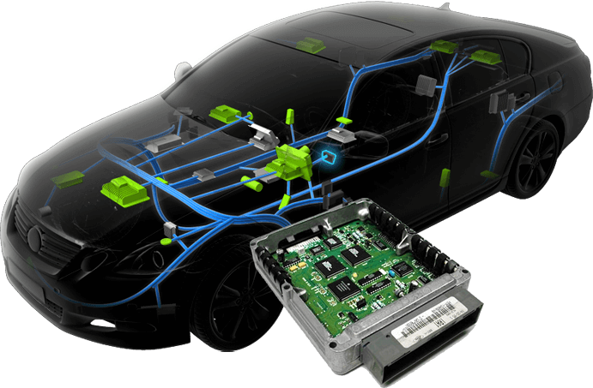
ECU (Electronics control unit)
An electronic control unit (ECU) is an embedded system in automotive electronics that controls one or more of the electrical systems or subsystems in a vehicle.
An electronic control unit (ECU) is a small device in a vehicle’s body that is responsible for controlling a specific function.
ECU receives inputs from different parts of the vehicle, depending on its function.

Slide 6
ABS vs without ABS

Slide 7
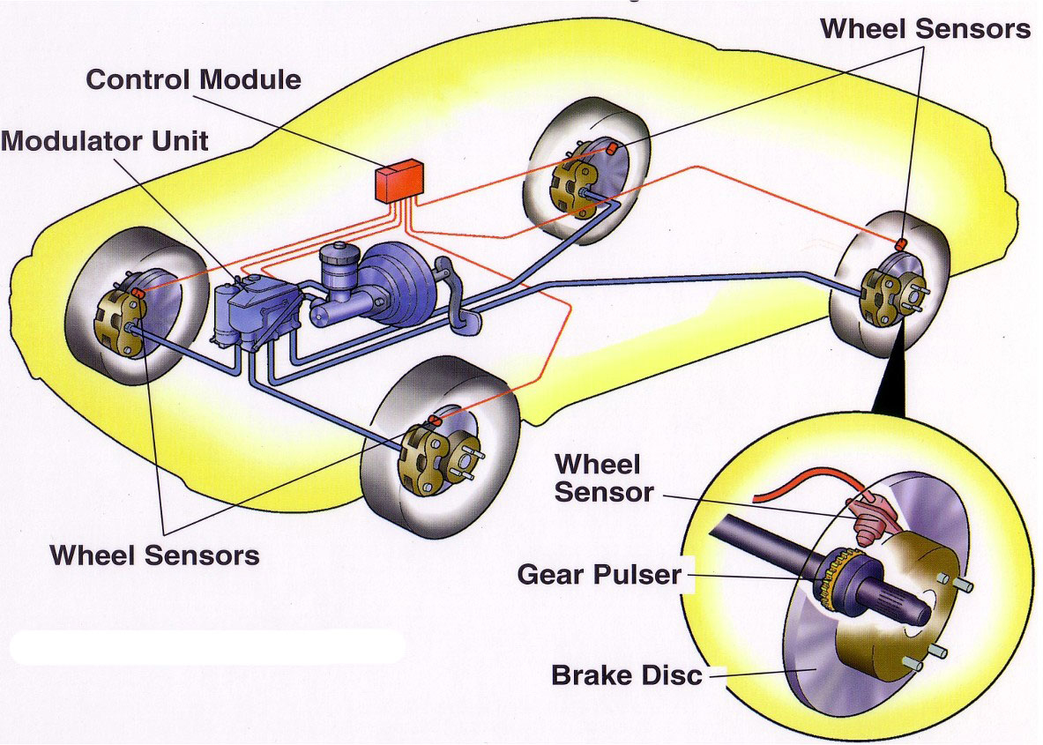
Anti-Lock breaking System

Slide 8
Front and Rear Sensor

Slide 9
SENSORS
MICRO-CONTROLLER
Components of Automotive Embedded System
MEMORY
DEVICES
TRANS-RECEIVER

Slide 10
CAN PROTOCOL
(Controller area network)

Slide 11
INTRODUCTION
CAN bus is a vehicle bus standard designed to allow microcontroller and devices to communicate with each other in vehicle.
It is a message based protocol.
It can send up to 8 bytes of data
It is present in both physical and data link layer of OSI layers.
It is a multi-master, multicast serial bus .
Standardized by ISO 11898-1, 11898-2
High Fault tolerance
Auto Re-transmit feature.

Slide 12
HISTORY
To reduce communication complexity on automobiles BOSCH starts work on CAN protocol in 1983, and official CAN released in 1986.
Intel and Philips are the first manufacture of CAN based microcontroller in 1987.
In 1991 CAN based first luxury car released by Mercedes Benz

Slide 13
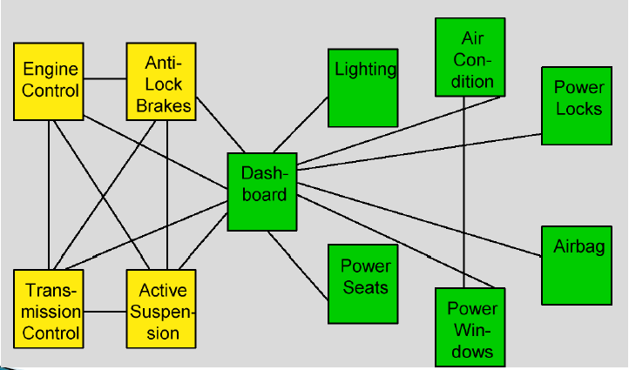
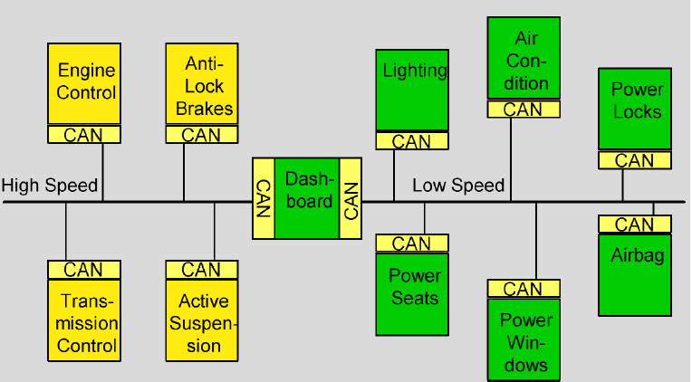
Before and After CAN

Slide 14
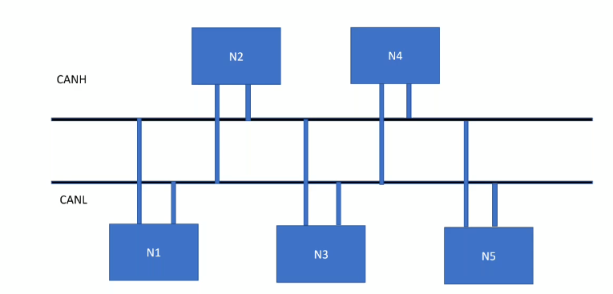
CAN STRUCTURE
Dominant - 0
Recessive - 1
Dominant voltage level - 1.5v to 2.5v
Recessive voltage level - Above 2.5v

Slide 15
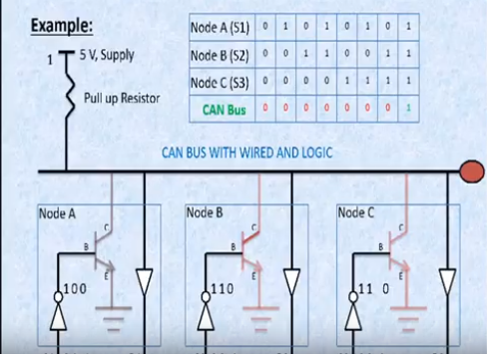
WIRED AND LOGIC

Slide 16
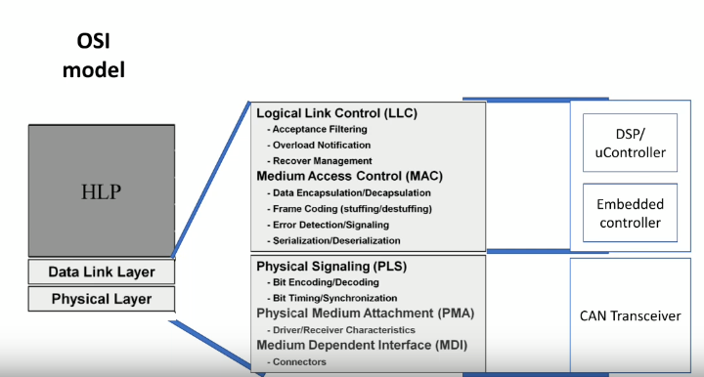
CAN with different layers in OSI model

Slide 17
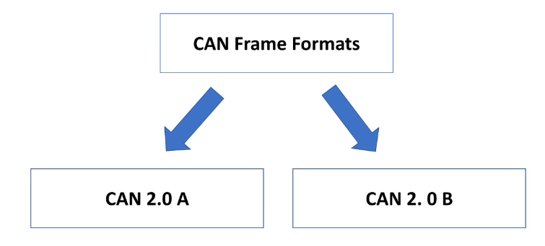
CAN FRAME FORMATS

Slide 18
TYPES OF FRAMES
Data frame
Error frame
Remote frame
Overload frame

Slide 19
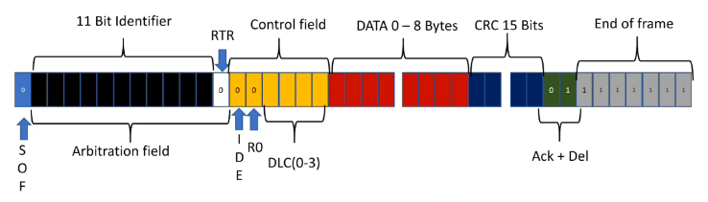
CAN 2.0A Message (or) Data frame
RTR - Remote Transfer Request
IDE - Identifier Extension Bit
DLC - Data Length Code
CRC - Cyclic Redundancy Check
EOF - End Of Frame

Slide 20
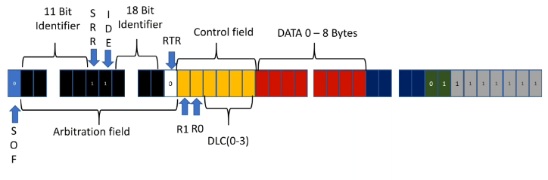
CAN 2.0 B Message Extened Message Frame

Slide 21
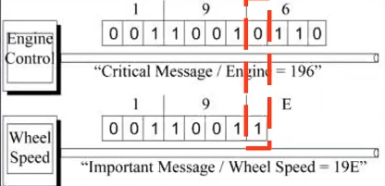
Message Arbitration

Slide 22
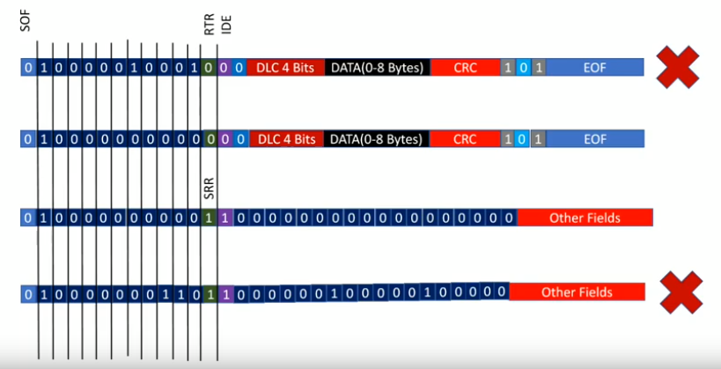
Multi master arbitration Data frame
NODE 1 (11bit)
NODE 2 (11bit)
NODE 3 (29 bit)
NODE 4 (29bit)

Slide 23
Fault Confinement
11
10
8
REC
NODE 2
TEC
1+8=9
1
CAN H
0
1 bit error
Rt
Rt
CAN L
REC
NODE 1
TEC
REC
NODE 3
TEC
20
12
16
21
19
If REC or TEC <=128
It becomes a passive error
20
If REC or TEC <=256
It goes to bus off state

Slide 24
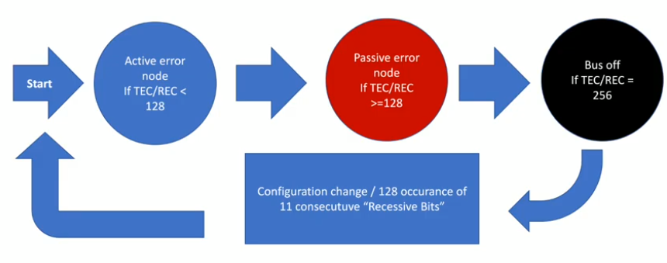
Fault Confinement

Slide 25
CAN ISOTP
A Classical CAN frame can carry maximum of 8 bytes of data
With ISO-TP:
The message is divided into multiple CAN frames and reconstructed by the receiver.
Types of ISO-TP Frames
Single Frame (SF)
First Frame (FF)
Flow Control (FC)
Consecutive Frame (CF)

Slide 26
CAN ISOTP - Single Frame (SF)
Used when the message size is 7 bytes or less.
CAN Frame Structure
PCI (protocol control information)
CAN ID
DLC
PCI
DATA (1 to 7 bytes)
0x7E0
8
07
01
02
03
04
05
06
07
PCI = 0x07
Lower Nibble = 7 → Length Information
Upper Nibble = 0 → Frame information
0x0X → Single Frame (SF)
0x1X → First Frame (FF)
0x2X → Consecutive Frame (CF)
0x3X → Flow Control (FC)

Slide 27
CAN ISOTP - First Frame (FF)
Used when the message is greater than 7 bytes.
Example : Suppose we want to send 20 bytes of data
CAN Frame Structure
PCI (protocol control information)
CAN ID
DLC
PCI
Length
First 6 bytes
Suppose the message length is 300 bytes.
300 Dec to Hex → 0X12C
Byte 0 = 0X11
Byte 1 = 0X2C
0x7E0
8
0X10
14
01
02
03
04
05
06
PCI = 0x10
Lower Nibble = 0 → Length Information
Upper Nibble = 1 → First Frame
The total message length is 12 bits, formed by combining:
Length = (Lower nibble of Byte0 << 8) | Byte1
Length = (0x0 << 8) | 0x14
= 0x014

Slide 28
CAN ISOTP - Flow Control (FC)
After receiving the First Frame, the receiver sends a Flow Control frame.
Purpose:
Allow or pause transmission
Specify how many Consecutive Frames may be sent
Specify the delay between frames
CAN Frame Structure
Flow Status (FS)
CTS(Continue to Send) - 0X30
Receiver :
Continue sending.
WT(Wait) - 0X31
Receiver:
Pause transmission and wait for next FC
Used when the receiver is temporarily busy.
OVFLW(Overflow) - 0X32
Receiver
My buffer is full.
Stop transmission (Abort)
CAN ID
DLC
FS
Block
Size
ST
Min (ms)
0x7E0
03
30
04
0A

Slide 29
CAN ISOTP - Flow Control (FC)
Sender
Receiver
Block Size
Block Size controls how many Consecutive Frames the sender may transmit before waiting for another Flow Control frame.
Example :
Block size is 4
FF
FC
CF1
CF2
CF3
CF4
If BS = 0
The sender transmits all remaining CFs without waiting for another FC frames.
Wait
FC
CF5
CF6

Slide 30
CAN ISOTP - Flow Control (FC)
STmin (Separation Time)
STmin defines the minimum delay between two Consecutive Frames.
STmin specifies the minimum time the sender must wait between transmitting Consecutive Frames.
Example :
STmin = 5 ms
CF1
5ms
CF2
5ms
CF3
5ms
0x7E0
03
30
04
05
CF4

Slide 31
CAN ISOTP - Consecutive Frame (CF)
After receiving FC, the sender starts transmitting the remaining data.
CAN ID
DLC
PCI
Data 0 to 7
0x7E0
8
21
01
02
03
04
05
06
07
PCI = 0x21
Lower Nibble =1 → Sequence Number
Upper Nibble =2 → Consecutive Frame
PCI = 0x22
Lower Nibble =2 → Sequence Number
Upper Nibble =2 → Consecutive Frame
0x7E0
8
22
01
02
03
04
05
06
07

Slide 32
Example: Transmitting 40 bytes of application data using CAN ISO-TP
Sender
Receiver
0x7E0 0x08 0x10 0x28 0x01 0x02 0x03 0x04 0x05 0x06
FF
0x7E8 0x03 0x30 0x04 0x0A
FC
10ms delay
0x7E0 0x08 0x21 0x07 0x08 0x09 0x0A 0x0B 0x0C 0x0D
CF1
10ms delay
0x7E0 0x08 0x22 0x0E 0x0F 0x10 0x11 0x12 0x13 0x14
CF2
10ms delay
0x7E0 0x08 0x23 0x15 0x16 0x17 0x18 0x19 0x1A 0x1B
CF3
10ms delay
Note :
If STmin = 5 ms:
Transmitting after 5 ms, 6 ms, or 10 ms is valid. Transmitting after 3 ms is not.
0x7E0 0x08 0x24 0x1C 0x1D 0x1E 0x1F 0x20 0x21 0x22
CF4
0x7E8 0x03 0x30 0x04 0x0A
FC
10ms delay
0x7E0 0x07 0x25 0x23 0x24 0x25 0x26 0x27 0x28
CF5
Transfer complete

Slide 33
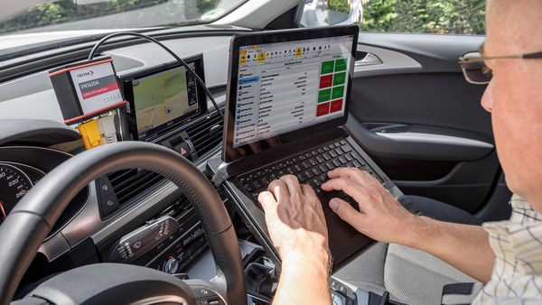

Diagnostics
Finding Root cause in defects

Slide 34
Why Diagnostics?
Identify defective components
Provide backup values to
Maintain safe driving
Minimize Emission
Report problem to driver

Slide 35
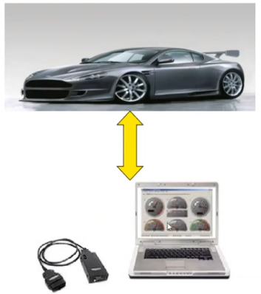
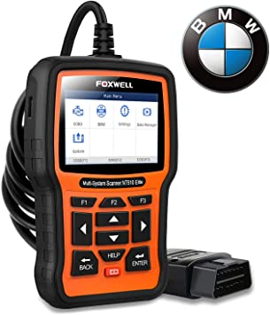
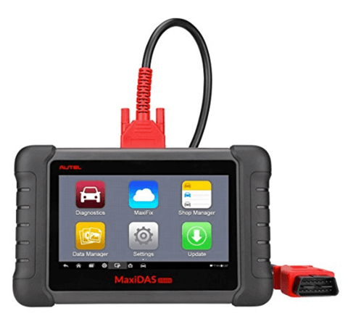
Diagnostic tester

Slide 36
Goal of diagnostic communication
Fulfilling its controlling functionality
Observation of control unit
Check reaction of control unit
Check and filter incoming signal
Read Error Memory (Source of error)

Slide 37
Protocols
KWP
UDS

Slide 38
KWP (Keyword Protocol)
KWP2000 or Keyword protocol 2000 is a on board diagnosis (OBD) protocol
ISO 14230 Standard
Compatible with K-LINE (ISO 9141) and CAN (ISO 11898)
Data rate of KWP is between 1.2 and 10.4 kilo baud and data fields up to 255 bytes.

Slide 39

Standard Protocol Tester Communication (SAE)

Slide 40
UDS (Unified Diagnostic Services)
To unify all the diagnostics standards that existed previously.
Off board Diagnostic Service Protocol with ISO standard 14229
Designed with combo of IS014230-3(KWP2000) and ISO15765-3 (DoCAN)
Message Size 8 bytes (max)
Compatible with CAN and LIN

Slide 41
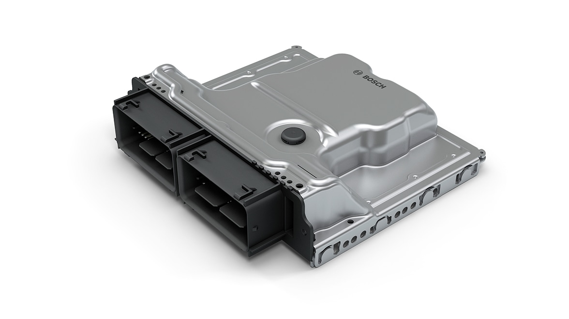
UDS Workings
Request
Response
Client
Server
Services
Request for Data
Write some Data
Running Test and get results
Flashing a Program
Clearing Memory and more..,

Slide 42
SID (Service Identifiers)
Service Identifier describes a type of service required form client to server
Length :1 byte
Range :0X00 to 0X3E
It will be present always a 1st byte of Service request message and its mandatory.

Slide 43
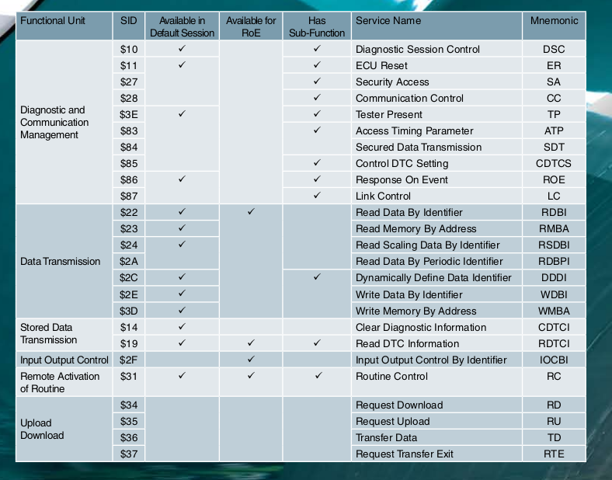

Slide 44
CAPL Script
CAPL - CAN Access Programming Language
Similar to C
Developed by Vector Informatik.
The execution of program blocks is controlled by events.
CAPL programs are developed and compiled in a dedicated browser.
CAPL Program Organization
1. Global Variable Declarations
2. Event Procedures
3. User-Defined Functions

Slide 45
CAPL Script Basic Structure
include
{
}
variables
{
local and system variable declaration;
}
Event
{
}
User defined functions()
{
}

Slide 46
Timer
It is a built-in peripheral that counts down from a specified time interval and used to generate a time delay.
Steps to use Timer
Declaring a Timer variable
Preset Timer
Start timer

Slide 47
Example : Send dummy ABS sensor data to CAN network node with 5000ms interval.
on timer abstimer //Start Timer
{
timercount++;
write(“ABS message is transmitting %d”,timercount);
setTimer(abstimer,5000);
}
include
{
}
variables
{
int timercount;
msTimer abstimer; //Timer variable initialization
}
on start
{
setTimer(abstimer,5000);//Preset timer
}

Slide 48
Diagnostics session 10H Services

Slide 49
Diagnostics Session 10Hex Service
The Diagnostic Session Control service is used to enable different diagnostic sessions in the server(s).
Request Message
Positive Response
Negative Response
Sub function

Slide 50
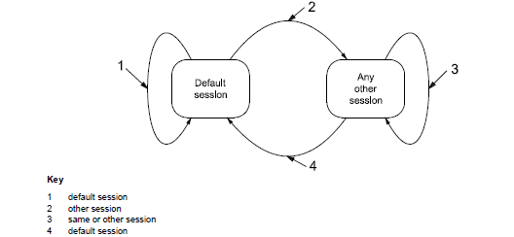

Slide 51
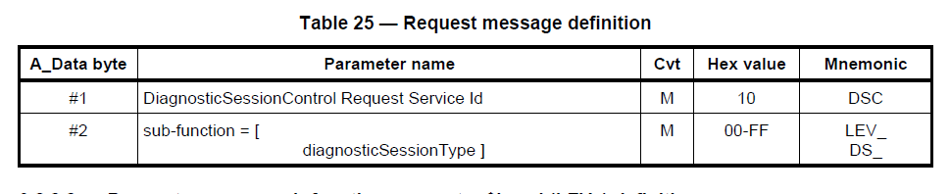
10H Request Frame Format
MESSAGE ID
NO.OF BYTES
SERVICE ID
SUB
FUNCTION
DID
DATA
DATA
DATA
DATA

Slide 52
Message ID
It can be any value, it does not affect any process, don’t use same message ID for some other frame.
Number of bytes
Data Identifier
DID is used to specify the data element which is to be read.
Example : 0XFB02 – distance travelled.

Slide 53
Data Record field
Read data by identifier - No need of data
Write Data by identifier - Needs data.
Eg : 0X9876 🡪 vehicle speed limit.

Slide 54
Sub functions
HEX | Subfunction
00 | ISOSAE Reserved
01 | Default Session
02 | Programming Session To upload software
03 | Extended Diagnostic Session To unlock additional diagnostic functions, such as the adjustment of sensors.
04 | Safety System Diagnostic Session To test all safety-critical diagnostic functions, such as airbag tests.
05-3F | ISOSAE Reserved
40-5F | Vehicle Manufacturer Specific
60-7E | System Supplier Specific
7F | ISOSAE Reserved

Slide 55
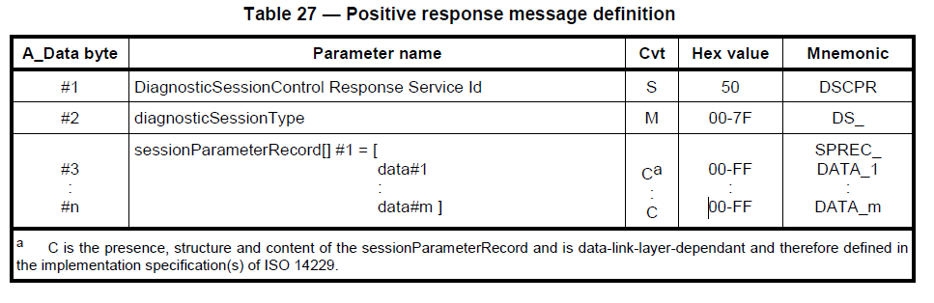
10H Positive Response frame format
Message ID
NO.OF BYTES
SERVICE ID+ 40
Sub
Function
Session Response time
1 bit Resolution
Response Time
10 bit resolution
DATA

Slide 56
Service ID - Actual Service ID + 40
Session Response time (1 bit)
It’s a minimum response time after request made by client.
Response time (10 bit resolution)
It’s a maximum response time after request made by client.

Slide 57
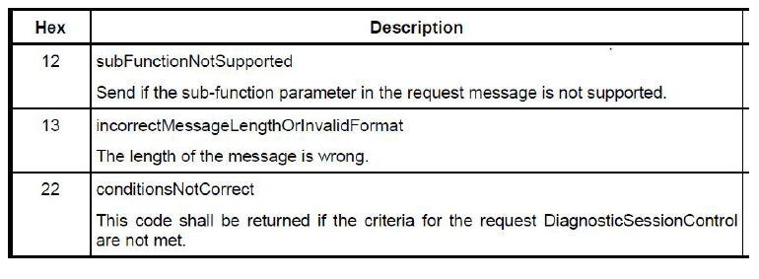
10H Negative Response frame format
MESSAGE ID
NO.OF BYTES
NR_SERVICE ID
SERVICE ID
NRC CODE

Slide 58
Example
Frame the Diagnostic session service with positive response for the following statement:
Subfunction : default session
Session response time : 50ms
Response time : 5000ms
Message ID : 450
Data record field : none

Slide 59
Session Response time calculation
Required time 50ms
Resolution 1 bit
Session response time = (Required time / resolution)
= 50 / 1
= (50)d
= (0X32)h

Slide 60
Response time calculation
Required time 5000ms
Resolution 10 bit
Response time = (Required time / resolution)
= (5000 / 10)
= (500)d
= (0X1F4)h

Slide 61
Client to Server Request
MESSAGE ID | NO.OF BYTES | SERVICE ID | SUB FUNCTION | DID | DATA | DATA | DATA
450
02
10
01
00
00
00
00

Slide 62
Server to Client Response
MESSAGE ID | NO.OF BYTES | SERVICE ID+ 40 | SUB FUNCTION | SESSION RESPONSE TIME (1 bit) | RESPONSE TIME (10 bit) | Data
480
06
50
01
00
32
01
F4
00

Slide 63
Server to Client Negative Response
MESSAGE ID | NO.OF BYTES | NR_SERVICE ID | SERVICE ID | NRC CODE
490
03
7F
10
12

Slide 64
Client to Server Request code
includes
{
}
variables
{
message diag_req _Request;
message diag_response _Response;
}
on start
{
}
on key 'w'
{
sessioncontrol(0x01);
}
void sessioncontrol(byte session)
{
if(session==1)
{
_Request.byte(0)=0x02;
_Request.byte(1)=0x10;
_Request.byte(2)=0x01;
_Request.byte(3)=0x0;
_Request.byte(4)=0x0;
_Request.byte(5)=0x0;
_Request.byte(6)=0x0;
_Request.byte(7)=0x0;
output(_Request);
}
}

Slide 65
Server to client Response
includes
{
}
variables
{
message diag_req _Request;
message diag_response _Response;
}
on message diag_req
{
write("Entered");
if(this.byte(1)==0x010)
{
if((this.byte(2)==0x01)&(this.byte(0)==0x02))
{
_Response.byte(0)=0x06;
_Response.byte(1)=0x50;
_Response.byte(2)=0x01;
_Response.byte(3)=0x00;
_Response.byte(4)=0x23;
_Response.byte(5)=0x03;
_Response.byte(6)=0x41;
_Response.byte(7)=0x0;
output(_Response);
}
}}

Slide 66
ECU Reset (11H) Services

Slide 67
ECU Reset Session 11Hex Service
The ECU Reset service is used by the client to request a server reset.
After ECU reset sever shall activate the default session
ECU reset mostly supports in extended diagnostic system

Slide 68
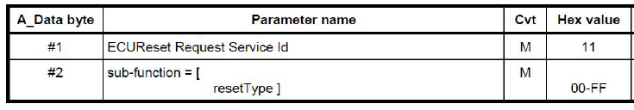
11H Request Frame Format
MESSAGE ID
NO.OF BYTES
SERVICE ID
SUB
FUNCTION
DATA
DATA
DATA
DATA
DATA

Slide 69
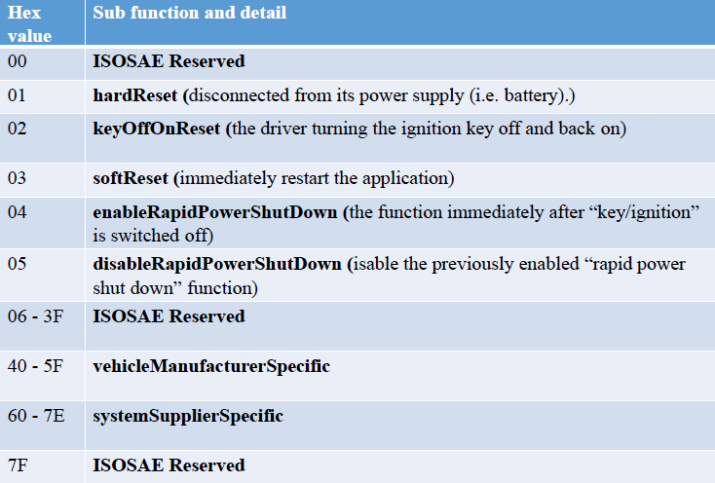
Sub functions

Slide 70
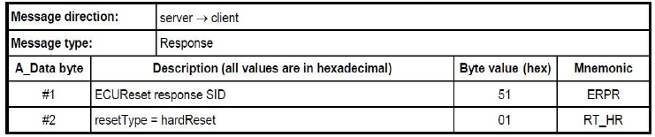
11H Positive Response frame format
Message ID
NO.OF BYTES
SERVICE ID+ 40
SUB
FUNCTION
DATA
DATA
DATA
DATA
DATA

Slide 71
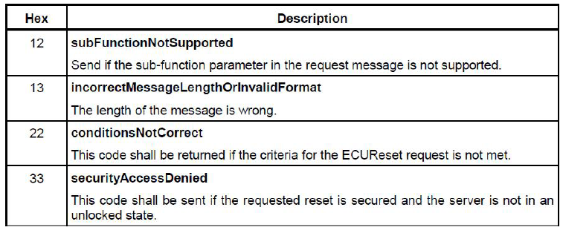
11H Negative Response frame format
MESSAGE ID
NO.OF BYTES
NR_SERVICE ID
SERVICE ID
NRC CODE
DATA
DATA
DATA
DATA

Slide 72
Example
Frame the ECU Reset service with positive response for the following statement:
Subfunction : Hard reset
Message ID : 450
Data record field : none

Slide 73
Client to Server Request
MESSAGE ID | NO.OF BYTES | SERVICE ID | SUB FUNCTION | DATA | DATA | DATA | DATA
450
02
11
01
00
00
00
00

Slide 74
Server to Client Response
MESSAGE ID | NO.OF BYTES | SERVICE ID+ 40 | SUB FUNCTION | Data
480
02
51
01
00

Slide 75
Server to Client Negative Response
MESSAGE ID | NO.OF BYTES | NR_SERVICE ID | SERVICE ID | NRC CODE
490
03
7F
11
12

Slide 76
Security Access (27H) Services

Slide 77
Security Access 27Hex Service
Protects modification of ECU data
Its implemented to restrict access for security emission, or safety reasons
Initially all ECU’s are will be in locked state
If we want write/read data from/to ECU we need a 27hex service

Slide 78
Security Access 27H Procedure
Client request for the “seed”
Server responds with “seed”
Client requests (sends) for the “Key”(respective for the seed received)
Server responds that the “key” was valid and that it will unlock itself.

Slide 79
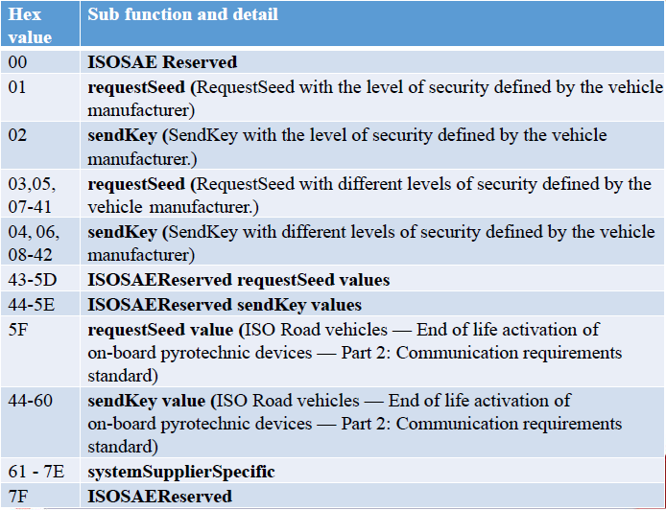

Slide 80
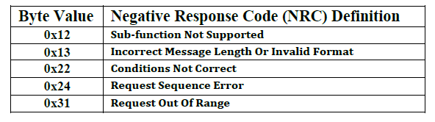
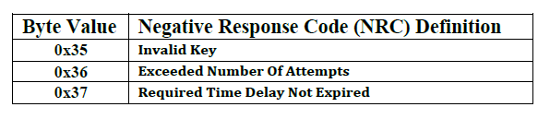
General Negative response codes
Security Access Specific Negative response codes

Slide 81
27Hex Request for seed Frame Format
MESSAGE ID | NO.OF BYTES | SERVICE ID | SUB FUNCTION | DATA | DATA | DATA | DATA
450
02
27
01
00
00
00
00

Slide 82
27Hex Positive Response seed Frame Format
MESSAGE ID | NO.OF BYTES | SERVICE ID | SUB FUNCTION | DATA | DATA | DATA | DATA
451
04
67
01
70
70
00
00

Slide 83
27Hex Request (Send) for Key Frame Format
MESSAGE ID | NO.OF BYTES | SERVICE ID | SUB FUNCTION | DATA | DATA | DATA | DATA
452
04
27
02
96
97
00
00

Slide 84
27Hex Positive Response seed Frame Format
MESSAGE ID | NO.OF BYTES | SERVICE ID | SUB FUNCTION | DATA | DATA | DATA | DATA
451
02
67
02
00
00
00
00

Slide 85
Task
Request
Response
Default session
ECU Reset Services
Request for seed
Send Key
Default session (Positive)
ECU Reset (Positive)
Positive response Seed
Positive Response key

Slide 86
Communication Control (28H) Services

Slide 87
Communication Control 28Hex Service
The service is used to control the communication of server
Enable or disable transmission or reception of messages from server

Slide 88
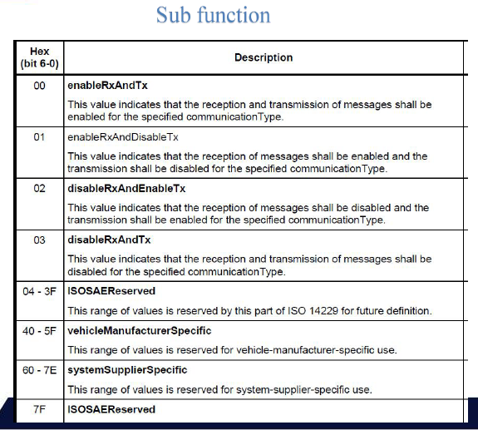

Slide 89
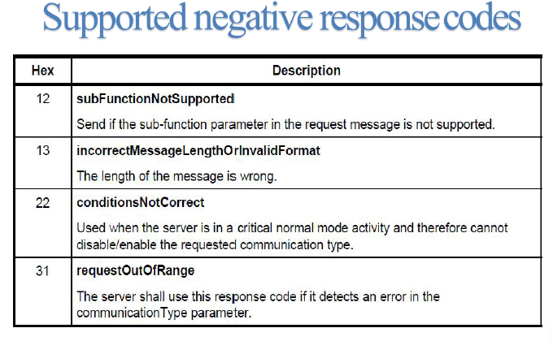

Slide 90
28Hex disable Tx and Rx
Client 🡪 Server
MESSAGE ID | NO.OF BYTES | SERVICE ID | SUB FUNCTION | Com Type | DATA | DATA | DATA
450
03
28
03
02
00
00
00

Slide 91
28Hex disable Tx and Rx Negative response
Server 🡪 Client
MESSAGE ID | NO.OF BYTES | NR_SERVICE ID | SERVICE ID | NRC CODE
490
02
7F
28
22

Slide 92
10Hex Extended Diagnostic session request
Client 🡪 Server
MESSAGE ID | NO.OF BYTES | SERVICE ID | SUB FUNCTION | Com Type | DATA | DATA | DATA
451
02
10
03
00
00
00
00

Slide 93
10Hex Extended Diagnostic session Positive response
Server 🡪 Client
MESSAGE ID | NO.OF BYTES | SERVICE ID+ 40 | SUB FUNCTION | SESSION RESPONSE TIME (1 bit) | RESPONSE TIME (10 bit) | Data
452
06
50
03
00
32
01
F4
00

Slide 94
27Hex Request for seed Frame Format
Client 🡪 Server
MESSAGE ID | NO.OF BYTES | SERVICE ID | SUB FUNCTION | DATA | DATA | DATA | DATA
453
02
27
01
00
00
00
00

Slide 95
27Hex Positive Response seed Frame Format
Server 🡪 Client
MESSAGE ID | NO.OF BYTES | SERVICE ID | SUB FUNCTION | DATA | DATA | DATA | DATA
454
06
67
01
70
70
80
90

Slide 96
27Hex Request (Send) for Key Frame Format
Client 🡪 Server
MESSAGE ID | NO.OF BYTES | SERVICE ID | SUB FUNCTION | DATA | DATA | DATA | DATA
455
04
27
02
96
97
54
23

Slide 97
27Hex Positive Response seed Frame Format
Server 🡪 Client
Server 🡪 Client
MESSAGE ID | NO.OF BYTES | SERVICE ID | SUB FUNCTION | DATA | DATA | DATA | DATA
456
02
67
02
00
00
00
00

Slide 98
28Hex disable Tx and Rx
Client 🡪 Server
MESSAGE ID | NO.OF BYTES | SERVICE ID | SUB FUNCTION | Com Type | DATA | DATA | DATA
457
03
28
03
02
00
00
00

Slide 99
28Hex disable Tx and Rx Positive response
Server 🡪 Client
MESSAGE ID | NO.OF BYTES | SERVICE ID | SUB FUNCTION | DATA | DATA | DATA | DATA
458
02
68
03
00
00
00
00

Slide 100
Tester present (3EH) Services

Slide 101
Tester Present 3EHex Service
The Tester Present UDS-service request is sent by the tester (client) to keep the ECU in the current diagnostic session, which will prevent the ECU from returning to the default diagnostic session.
This service is used to keep one or multiple servers in a diagnostic session other than the default Session

Slide 102
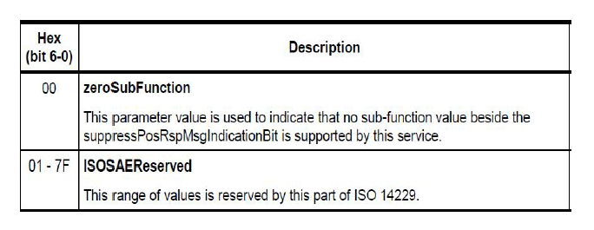
Subfunction

Slide 103
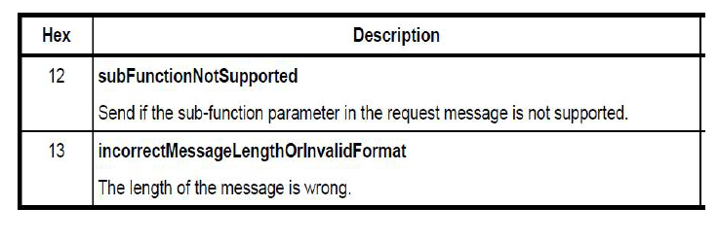
Negative response

Slide 104
3EHex Request with zero subfunction Frame Format
Client 🡪 Server
MESSAGE ID | NO.OF BYTES | SERVICE ID | SUB FUNCTION | DATA | DATA | DATA | DATA
453
02
3E
00
00
00
00
00

Slide 105
3EHex Positive Response Frame Format
Server 🡪 Client
Server 🡪 Client
MESSAGE ID | NO.OF BYTES | SERVICE ID | SUB FUNCTION | DATA | DATA | DATA | DATA
456
02
7E
00
00
00
00
00

Slide 106
3EHex Request with 80 subfunction Frame Format
Client 🡪 Server
MESSAGE ID | NO.OF BYTES | SERVICE ID | SUB FUNCTION | DATA | DATA | DATA | DATA
458
02
3E
80
00
00
00
00

Slide 107
3EHex Positive Response Frame Format
Server 🡪 Client
Server 🡪 Client
MESSAGE ID | NO.OF BYTES | SERVICE ID | SUB FUNCTION | DATA | DATA | DATA | DATA
460
02
7E
00
00
00
00
00

Slide 108
Secured data transmission (84H) Services

Slide 109
Secured Data Transmission 84Hex Services
The purpose of this service is to transmit data that is protected against attacks from third parties, which could endanger data security
No subfunctions
In a secured mode, only confirmed services are allowed
The below services are not allowed
1. Response On Event (86 hex);
2. Read Data By Periodic Identifier (2A hex);
3. Tester Present (3E hex).

Slide 110
Secured Data Transmission 84Hex Request frame Services
Client 🡪 Server
MESSAGE ID | NO.OF BYTES | SERVICE ID | DATA | DATA | DATA | DATA | DATA
DATA
350
07
84
11
22
33
44
55
66

Slide 111
84Hex Positive Response Frame Format
Server 🡪 Client
Server 🡪 Client
MESSAGE ID | NO.OF BYTES | SERVICE ID | DATA | DATA | DATA | DATA | DATA
DATA
460
07
C4
11
22
33
44
55
66

Slide 112
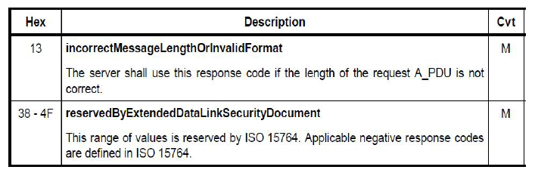
84Hex Supported Negative Response

Slide 113
84Hex Negative Response
MESSAGE ID | NO.OF BYTES | NR_SERVICE ID | SERVICE ID | NRC CODE
421
03
7F
84
13

Slide 114
Control DTC Setting (85H) Services

Slide 115
Control DTC Setting 85H
DTC are used by the automobile manufacturer to diagnose problems related to vehicle.
The Control DTC Setting enables the tester (client) to control the updating of the Diagnostic Trouble Codes (DTC:s) in the ECU:s.
Generally its used to disable DTC update while preprogramming and enable on post programming.

Slide 116
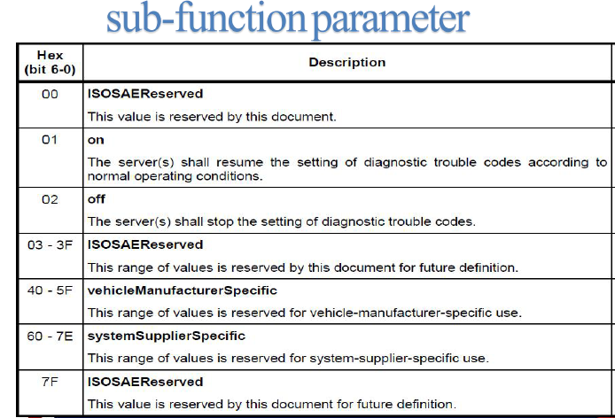

Slide 117
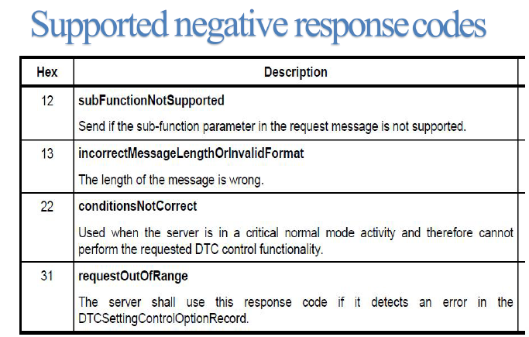

Slide 118
Control DTC Setting 85H Request frame Services
Client 🡪 Server
MESSAGE ID | NO.OF BYTES | SERVICE ID | SUB FUNCTION | DATA | DATA | DATA | DATA
DATA
352
02
85
01
00
00
00
00
00

Slide 119
Control DTC Setting 85H Positive Response Frame Format
Server 🡪 Client
Server 🡪 Client
MESSAGE ID | NO.OF BYTES | SERVICE ID | DATA | DATA | DATA | DATA | DATA
DATA
460
02
C5
01
00
00
00
00
00

Slide 120
Link control 87hex service
The Link Control service is used to control the communication link baud rate between the client and the server(s) for the exchange of diagnostic data.
This service optionally applied.

Slide 121
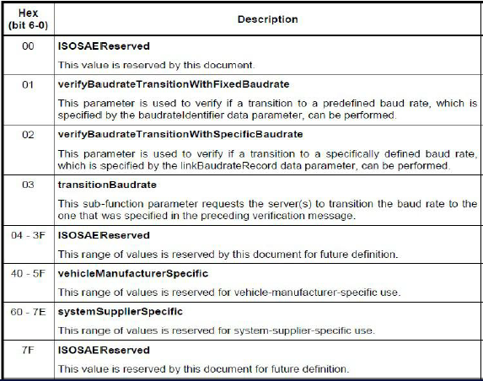
Request message subfunction

Slide 122
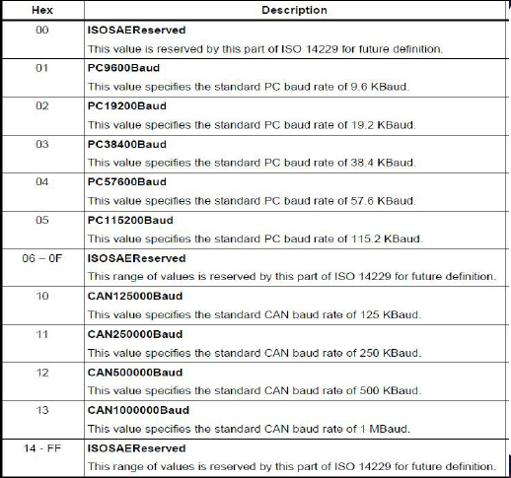
Baud rate

Slide 123
Link control 87H Request frame Services
Client 🡪 Server
MESSAGE ID | NO.OF BYTES | SERVICE ID | SUB FUNCTION | Baud Rate | DATA | DATA | DATA
DATA
350
03
87
01
05
00
00
00
00

Slide 124
Link control 87H Positive Response Frame Format
Server 🡪 Client
Server 🡪 Client
MESSAGE ID | NO.OF BYTES | SERVICE ID | SUB FUNCTION | DATA | DATA | DATA | DATA
DATA
462
02
C7
01
00
00
00
00
00

Slide 125
Data Transmission functional unit
Read data by identifier (22hex)
Read Memory by address (23hex)
Read Scaling data by Identifier (24hex)
Read data by periodic identifier (2Ahex)
Dynamically define data identifier (2Chex)
Write data by identifier (2Ehex)
Write Memory by address (3Dhex)

Slide 126
Flow control
If we want to receive more than 8 bytes of data we need to use flow control method
Types of frames
Single Frame - 00 H
First frame - 10 H
Consecutive frame - 21 H
Flow control frame - 20 H

Slide 127
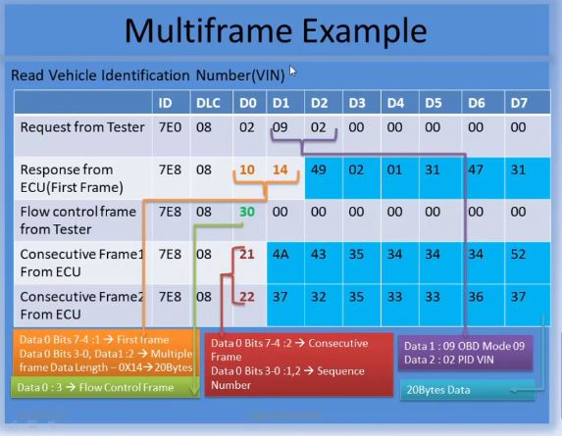

Slide 128
Read data by identifier 22Hex Service
The Read Data By Identifier service allows the client to request data record values from the server identified by one or more data Identifiers
No subfunction

Slide 129
Read data by identifier 22H Request frame
Read RPM lets take RPM as 5000 and Data identifier as 0141
Client 🡪 Server
MESSAGE ID | NO.OF BYTES | SERVICE ID | DATA IDENTIFIER | DATA IDENTIFIER | DATA | DATA | DATA
DATA
352
03
22
01
41
00
00
00
00

Slide 130
Read data by identifier 22H Positive Response frame
Server 🡪 Client
MESSAGE ID | NO.OF BYTES | SERVICE ID | DATA IDENTIFIER | DATA IDENTIFIER | DATA | DATA | DATA
DATA
359
05
62
01
41
13
88
00
00

Slide 131
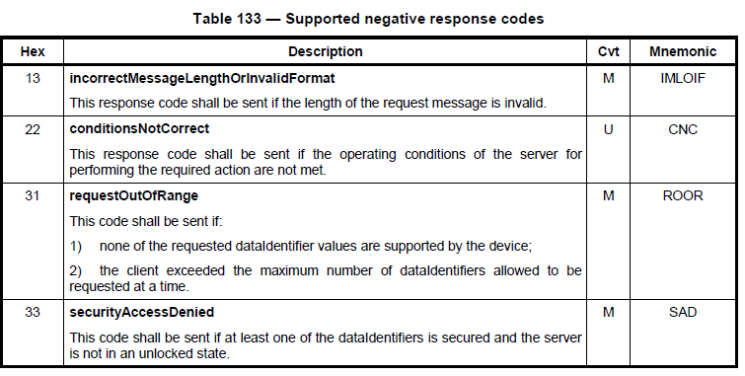

Slide 132
Read data by identifier 22Hex Negative Response
MESSAGE ID | NO.OF BYTES | NR_SERVICE ID | SERVICE ID | NRC CODE
421
03
7F
22
31

Slide 133
Read Memory by Address 23Hex Service
The Read Memory By Address service allows the client to request memory data from the server via a provided starting address and to specify the size of memory to be read.
No subfunction

Slide 134
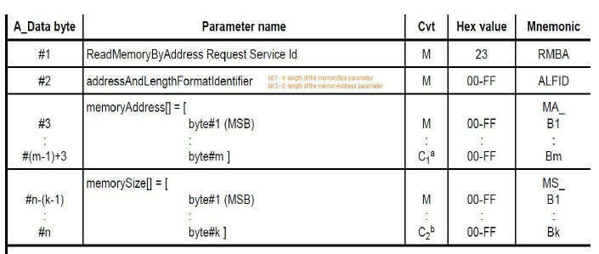
Request

Slide 135
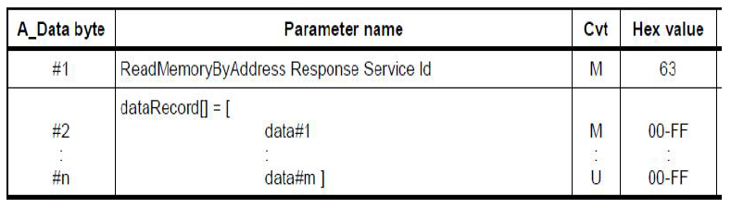
Positive response

Slide 136
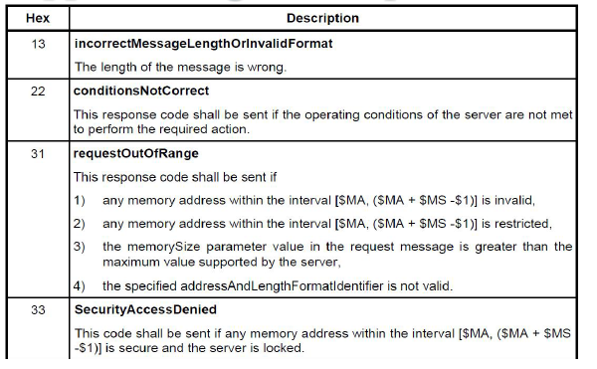
Negative response

Slide 137
Read data by Memory address 23H Request frame
Client 🡪 Server
MESSAGE ID | FIRST FRAME | NUMBER OF BYTES | SID | ADDRESS AND LENGTH | Mem Add 1 | Mem Add 2 | Mem Add 3
Mem
Add 4
350
10
0F
23
66
11
22
33
44

Slide 138
Read data by Memory address 23H Request flow control frame
Server 🡪 Client
MESSAGE ID | FLOW CONTROL | DATA | DATA | DATA | DATA | DATA | DATA
DATA
352
30
00
00
00
00
00
00
00

Slide 139
Read data by Memory address 23H Request flow control frame
Client 🡪 Server
MESSAGE ID | Consecutive FRAME | Mem Add 5 | Mem Add 6 | Mem Size 1 | Mem Size 2 | Mem Size 3 | Mem Size 4
Mem
Size 5
352
21
05
06
01
02
03
04
05

Slide 140
Read data by Memory address 23H Request flow control frame
Client 🡪 Server
MESSAGE ID | Consecutive FRAME | Mem Size 6 | DATA | DATA | DATA | DATA | DATA
DATA
352
22
06
07
00
00
00
00
00

Slide 141
Read data by Memory address 23H Request frame
Server🡪 Client
MESSAGE ID | FIRST FRAME | NUMBER OF BYTES | SID + 40 | DATA 1 | DATA 2 | DATA 3 | DATA 4
DATA 5
350
10
0E
63
21
22
23
24
25

Slide 142
Read data by Memory address 23H Request flow control frame
Client 🡪 Server
MESSAGE ID | FLOW CONTROL | DATA | DATA | DATA | DATA | DATA | DATA
DATA
352
30
00
00
00
00
00
00
00

Slide 143
Read data by Memory address 23H Request flow control frame
Client 🡪 Server
MESSAGE ID | Consecutive FRAME 1 | DATA 6 | DATA 7 | DATA 8 | DATA 10 | DATA 11 | DATA 12
DATA 13
352
21
26
27
28
29
30
31
32

Slide 144
Read data by Memory address 23H Request flow control frame
Client 🡪 Server
MESSAGE ID | Consecutive FRAME 2 | DATA 14 | DATA | DATA | DATA | DATA | DATA
DATA
352
22
33
00
00
00
00
00
00

Slide 145
Write data by identifier 2EHex Service
The Write Data By Identifier service allows the client to write information into the server at an internal location specified by the provided data identifiers.
The data may or may not be secured.

Slide 146
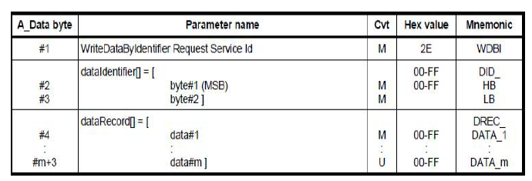
Request message definition

Slide 147
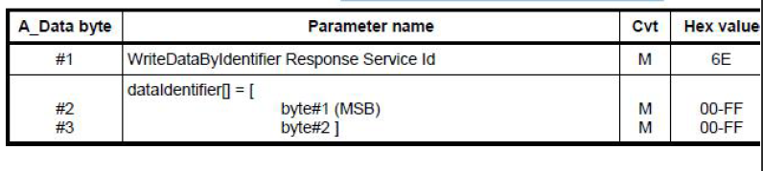
Positive response

Slide 148
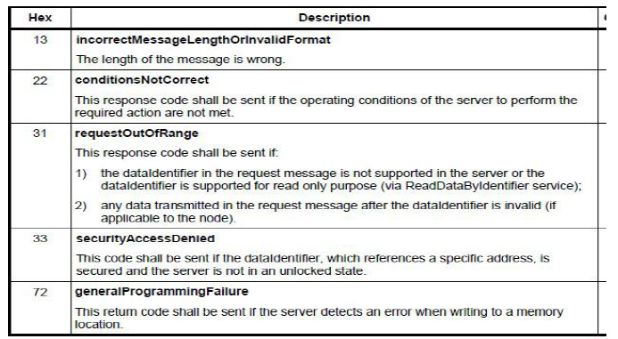
Negative response

Slide 149
Write data by Identifier 2EH Request frame
Client 🡪 Server
MESSAGE ID | NUMBER OF BYTES | SID | DATA IDENTIFIER | DATA IDENTIFIER | DATA | DATA | DATA
DATA
350
04
2E
11
22
55
00
00
00

Slide 150
Write data by Identifier 2EH Positive Response frame
Server 🡪 Client
MESSAGE ID | NO.OF BYTES | SERVICE ID | DATA IDENTIFIER | DATA IDENTIFIER | DATA | DATA | DATA
DATA
359
03
6E
11
22
00
00
00
00

Slide 151
Write Memory by Address 3DHex Service
The Write Memory By Address service allows the client to write information into the server at one or more contiguous memory locations
No subfunction

Slide 152
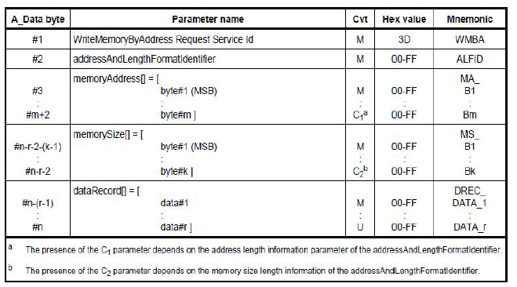
Request

Slide 153
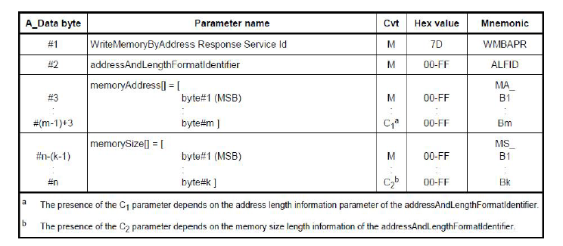
Positive response

Slide 154
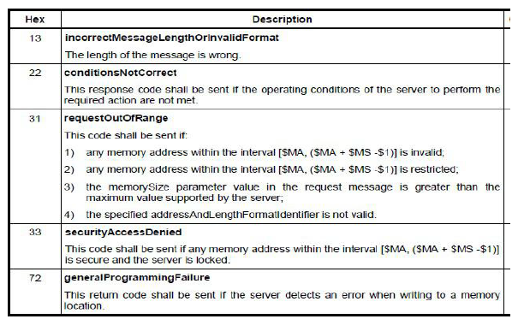
Negative response

Slide 155
Let address and length format identifier as 42
4(bytes of) - Memory Size
2(bytes of) - Memory Address

Slide 156
Write data by identifier 3DH send Memory address Request frame
Server🡪 Client
MESSAGE ID | FIRST FRAME | NUMBER OF BYTES | SID | ADDRESS AND LENGTH | Mem Add 1 | Mem Add 2 | Mem Add 3
Mem
Add 4
350
10
0D
3D
44
01
02
03
04

Slide 157
Write data by identifier 3DH flow control response frame
Server 🡪 Client
MESSAGE ID | FLOW CONTROL | DATA | DATA | DATA | DATA | DATA | DATA
DATA
350
30
00
00
00
00
00
00
00

Slide 158
Write data by identifier 3DH Memory size Request frame
Client 🡪 Server
MESSAGE ID | Consecutive FRAME | Mem Size 1 | Mem Size 2 | Mem Size 3 | Mem Size 4 | DATA | DATA
DATA
352
21
05
06
07
08
55
66
77

Slide 159
Write data by identifier 3DH send Memory address Positive Response frame (Memory Address)
Server 🡪 Client
MESSAGE ID | FIRST FRAME | NUMBER OF BYTES | SID + 40 | ADDRESS AND LENGTH | Mem Add 1 | Mem Add 2 | Mem Add 3
Mem
Add 4
350
10
0A
7D
44
01
02
03
04

Slide 160
Write data by identifier 3DH flow control request frame
Client 🡪 Server
MESSAGE ID | FLOW CONTROL | DATA | DATA | DATA | DATA | DATA | DATA
DATA
350
30
00
00
00
00
00
00
00

Slide 161
Write data by identifier 3DH Memory size Positive Response frame (Memory Size)
Server 🡪 Client
MESSAGE ID | Consecutive FRAME | Mem Size 1 | Mem Size 2 | Mem Size 3 | Mem Size 4 | DATA | DATA
DATA
352
21
05
06
07
08
00
00
00

Slide 162
Read Scaling data by identifier 24H Service
The Read Scaling Data By Identifier service allows the client to request scaling data record information from the server identified by a data Identifier
No subfunctions

Slide 163

Request

Slide 164

Positive Response

Slide 165
Example
Lets get the VIN of vehicle using Scaling data
Use Format identifier as
0XF1 0X90
VIN will be 17bytes value

Slide 166
Read Scaling data by identifier 24H Service Request frame
Client 🡪Server
MESSAGE ID | NO.OF BYTES | SERVICE ID | SERVICE ID | NRC CODE
421
03
24
F1
90

Slide 167
Read Scaling data by identifier 24H Service Response frame
Server 🡪Client
MESSAGE ID | Number of bytes | SID+40 | Identifier | Identifier | Scaling bytes | Scaling bytes | Scaling bytes extension
352
05
64
F1
90
6F
62
05

Slide 168
Explanation
0x6F ->
Higher nibble – 6 represents that the value is an ASCII value
Lower nibble – F represents the total number of bytes, in this case, 15 bytes of VIN
0x62 ->
Higher nibble – 6 represent an ASCII value
Lower nibble – 2 represents the 2 leftover bytes of the VIN

Slide 169

Negative Response

Slide 170
Stored data Transmission Functional unit
Clear diagnostic information 14Hex services
Read DTC information (19Hex) Services

Slide 171
Clear diagnostic Information 14H
Allows the client to clear diagnostic information from the server (including DTC, captured data, etc)
Permanent DTCs shall be stored in non-volatile memory and cannot be cleared by any test equipment

Slide 172


Request

Slide 173


Positive Response
Supported Negative Response

Slide 174
Clear diagnostic Information 14H Request frame
Client 🡪 Server
MESSAGE ID | No.of bytes | SID | High byte | Mid byte | Low Byte | DATA | DATA
DATA
352
04
14
01
02
03
00
00
00

Slide 175
Clear diagnostic Information 14H Positive Response frame
Server 🡪 Client
MESSAGE ID | No.of bytes | SID | High byte | Mid byte | Low Byte | DATA | DATA
DATA
352
01
54
00
00
00
00
00
00

Slide 176
Read DTC Information 19H Services
This service allows a client to read the status of server-resident Diagnostic Trouble Code (DTC) information from any server or group of servers within a vehicle.

Slide 177

DTC (Diagnostics Trouble code)
DTC code may contain 2 or 3 bytes. Basically, DTC code has DTC high bytes and DTC middle bytes while the last byte is optional

Slide 178

DTC Bytes

Slide 179

Request

Slide 180

Positive response

Slide 181
Read Number of DTC Present in ECU (19H Services Request frame)
Client 🡪 Server
MESSAGE ID | No.of bytes | SID | Sub function | DTC status mask | DATA | DATA | DATA
DATA
352
02
19
01
55
00
00
00
00

Slide 182
Read Number of DTC Present in ECU (19H Services Response frame)
Server 🡪 Client
MESSAGE ID | No.of bytes | SID | Sub function | DTC status mask | DTC Format identifier | DATA | DATA
DATA
352
04
59
01
08
03
04
00
00

Slide 183
Input output control by identifier 2Fhex Service
The client requests the control of an input / output specific to the server.
The Input Output Control By Identifier service is used by the client to substitute a value for an input signal, internal server function and/or control an output (actuator) of an electronic system

Slide 184

Request

Slide 185

Positive response

Slide 186


Slide 187
Engine ideal speed identifier
Example :
Desired ideal speed adjustment identifier – 01 32
Control option record – 0x01 (reset to default )
Return ideal speed as 750/min

Slide 188
Request frame to set ideal engine speed as default
Client 🡪 Server
MESSAGE ID | No.of bytes | SID | Data Identifier | Data Identifier | Control Status Record | DATA | DATA
DATA
352
04
2F
01
32
01
00
00
00

Slide 189
Response frame for set ideal engine speed as default
Client 🡪 Server
MESSAGE ID | No.of bytes | SID | Data Identifier | Data Identifier | Control Status Record | Control State #1 | DATA
DATA
354
02
6F
01
32
01
4B
00
00

Slide 190
Routine control (31H) Services

Slide 191
Routine control 31H Services
The client requests to start, stop a routine in the server(s) or
requests the routine results.

Slide 192
Routine Control 31H
If the client starts routine on server’s memory its responsible for stopping the routine
Routine shall be started after request made by client and its sends positive response
Client may request routine results after the routine has been stopped.

Slide 193
Services
Start a routine
Stop a routine
Request routine
Results
Routine is referenced by a two-byte routine Identifier.

Slide 194

Request

Slide 195

Sub functions

Slide 196

Positive response

Slide 197

Supported negative response

Slide 198

Upload and download functional unit

Slide 199
Request download 34Hex
The request Download service is used by the client to initiate a data transfer from the client to the server (download)
After the server has received the request Download request message, the server shall take all necessary actions to receive data before it sends a positive response message

Slide 200

Request

Slide 201
Data format identifier:
Each nibble encode separately
High nibble specifies the compression method
Low nibble specifies the encryption mode
If the data identifier is 0X00 🡪 No compression and encryption
Address and length format identifier
Each nibble encoded separately
High nibbles indicates Memory Size (7-4)
Low nibble indicates Memory Address(3-0)

Slide 202

Positive response

Slide 203

Supported negative response codes

Slide 204
Length format identifier
Each nibble encode separately
High nibble specifies the length of maximum number of blocks (7-4)
Low nibble depends on vehicle manufacturers.
Maximum Number of block length
It return the number , that number indicate how many data bytes been transmitted in a single transfer, which reflects the complete message length, including the service identifier

Slide 205
Request upload 35Hex
The request Download service is used by the client to initiate a data transfer from the Server to the Client(Upload)
After the server has received the request Upload request message, the server shall take all necessary actions to Send data before it sends a positive response message

Slide 206

Request

Slide 207

Positive response

Slide 208

Supported negative response

Slide 209
Service Transfer data (36 Hex)
The Transfer Data service is used by the client to transfer data either from the client to the server (download) or from the server to the client (upload).
Combination of Request Download or Request Upload service.
The Transfer Data service request includes a block Sequence Counter to allow for improved error handling in case a Transfer Data service fails during a sequence of multiple Transfer Data requests

Slide 210

Request

Slide 211

Positive response

Slide 212

Request Transfer exit
This service is used by the client to terminate a data transfer between client and server (upload or download).

Slide 213

Positive response

Slide 214

Negative response

